Slide 1
Introduction to General Linear Models
BIO782P 2017

Slide 2
Recap

Slide 3


Textbooks
Grafen, A and Hails, R (2002)
Modern Statistics for the Life Sciences, Oxford University Press.

Slide 4
One-way ANOVA
Divide the variation in the response variable into two parts:
Variation between groups
Variation within groups

Slide 5
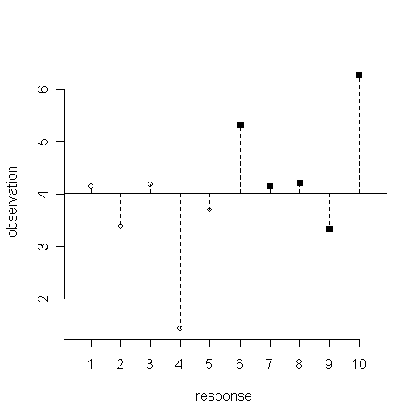
Total SS

Slide 6
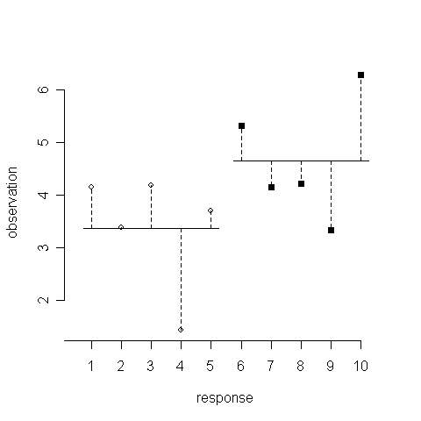
Error SS

Slide 7
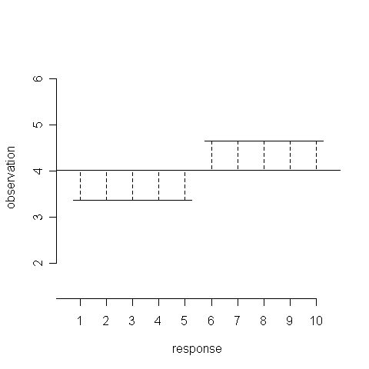
Treatment SS

Slide 8
One-way ANOVA
Df Sum Sq Mean Sq F value Pr(>F
Treatment 1 1.721 1.721 1.694 0.234
Residuals 7 7.109 1.016

Slide 9
Regression
We divide the variation in the response variable into two parts:
Variation of the fitted line from the mean
Variation around the fitted line

Slide 10
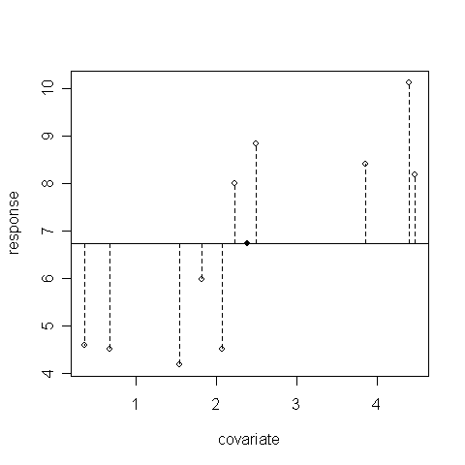
Total SS

Slide 11
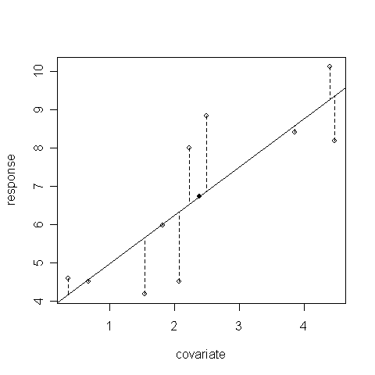
Error SS

Slide 12
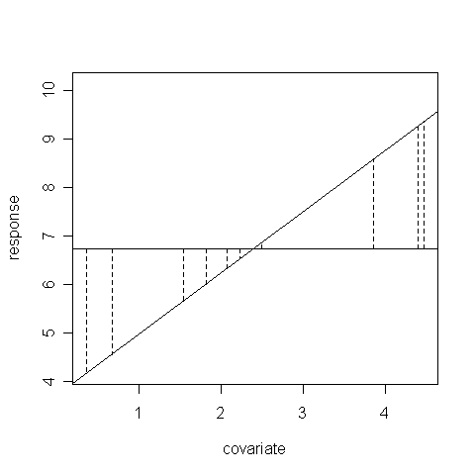
Effect SS

Slide 13
> anova(lm(dum2~dum1))
Analysis of Variance Table
Response: dum2
Df Sum Sq Mean Sq F value Pr(>F)
dum1 1 30.164 30.164 17.316 0.00316 **
Residuals 8 13.936 1.742
---
Signif. codes: 0 ‘***’ 0.001 ‘**’ 0.01 ‘*’ 0.05 ‘.’ 0.1 ‘ ’ 1

Slide 14
The General Linear Model
It should now be clear that both ANOVA and regression have a very similar structure.
Both involve partitioning variance (sums of squares) into those due to the explanatory variable, and those due to error.
Both are special cases of a general linear model, which also includes much more complicated models – much is familiar. We even get an ANOVA table.

Slide 15
The General Linear Model
ANOVA: for a response weight_gain and explanatory factor diet
Weight gain_{i,j} = diet_{i} + ε_{i,j}
REGRESSION: for a response height, with continuous explanatory variable y
height_{i} = α + β.y + ε_{i}
In each case, ε is x sampled from a normal distribution with mean 0 and standard deviation s (estimated from the data) for every y

Slide 16
GLM model formulae
Model formulae are a way of describing how the analysis of variance is to be performed: literally, how the variance is to be divided up. You can use these formulae as input to R. Importantly, many other statistics packages use the same approach.
weight_gain ~ diet
height ~ rainfall
leaf.area~height+water
grazing~pH+temperature+oxygen
grazing~pH+temperature+oxygen+pH:oxygen
grazing~pH*temperature*oxygen
grazing~(pH+temperature+oxygen)^2

Slide 17
Why GLM?
The power of the GLM approach is that we can partition the variance in a response variable between any number of continuous and categorical explanatory variables e.g.
height = rainfall + altitude + terrain
rainfall and altitude are continuous,
terrain categorical
Height_{i,j,k} = rainfall_{i} + altitude_{j} + β.terrain_{i,j,k} + ε_{i,j,k}

Slide 18
Using GLMs
Taking the level of one explanatory variable into account will change the significance of another variable
Total SS is the same in each case,
Error SS decreases because some of the variance that was previously calculated as error variance is explained by the second explanatory variable

Slide 19
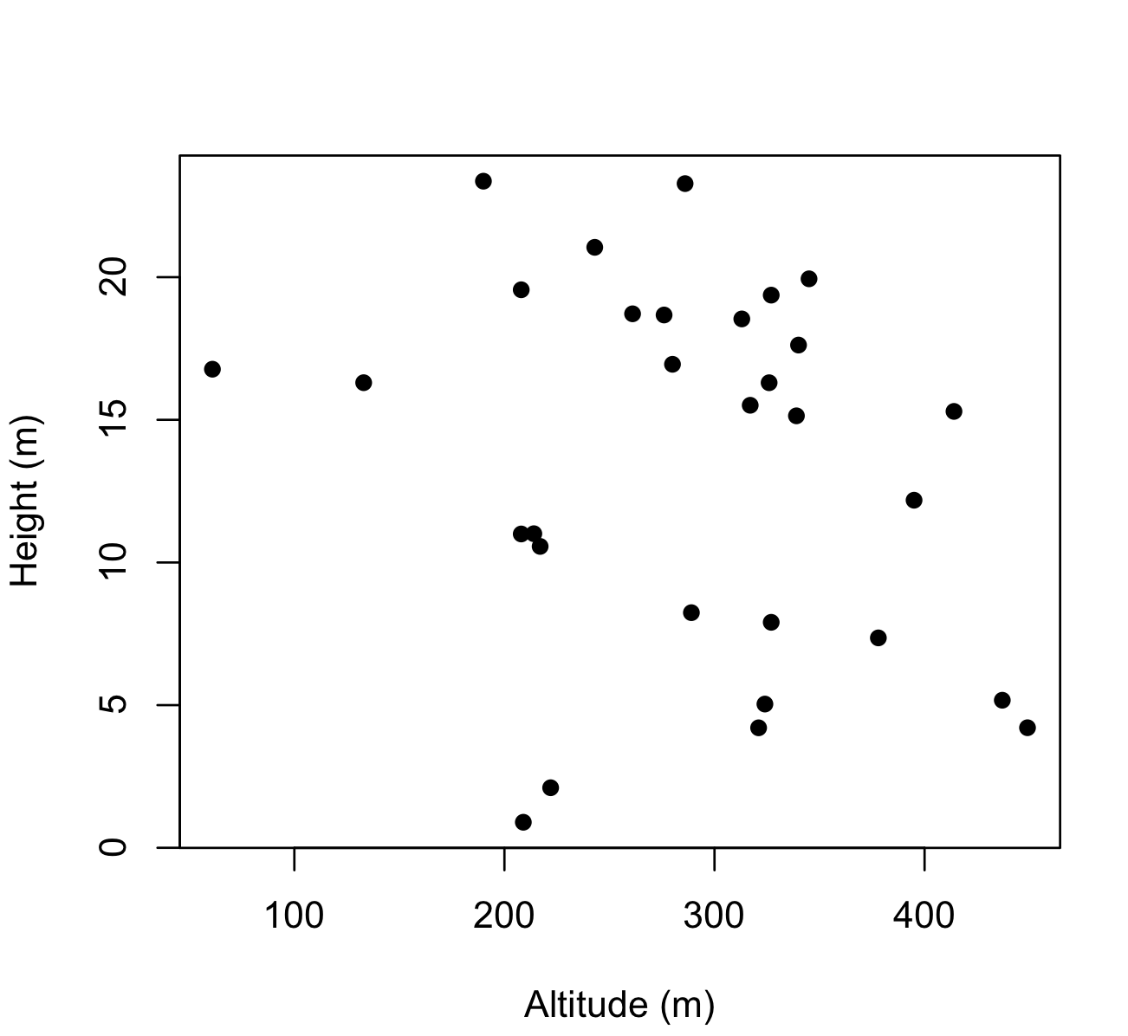
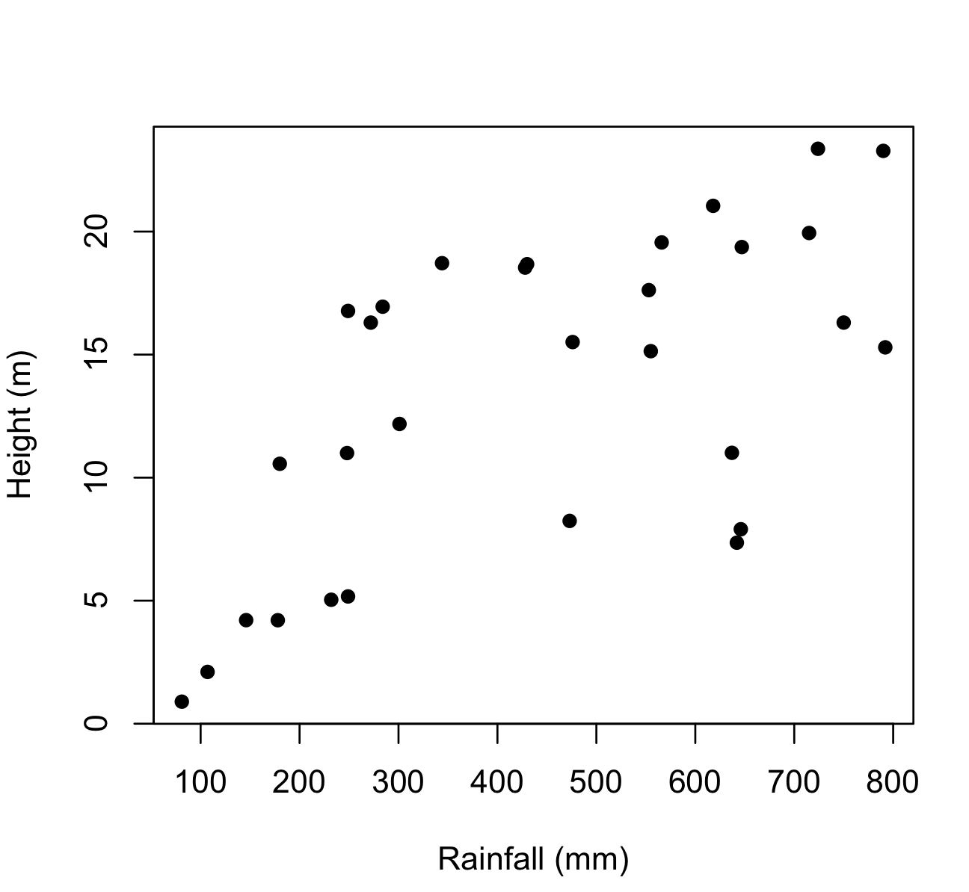
Fit model for two variables

Slide 20
Partitioning SS
Sequential SS altitude = SS for altitude (first variable fitted)
Seq SS rainfall = errorSS_{altitude} – errorSS_{altitude+rainfall}
Total SS = SS_{altitude +} errorSS_{altitude}
Total SS = SS_{altitude} + SS_{rainfall} + errorSS_{altitude+rainfall}

Slide 21
Partitioning SS and df
Total SS
29 df
SS_{altitude}
1 df
Error SS_{altitude}
28 df
SS_{rainfall}
1 df
Error SS_{altitude,rainfall}
27 df

Slide 22
Partitioning SS and df
> mod1<-lm(height~altitude+rainfall)
> anova(mod1)
Analysis of Variance Table
Response: height
Df Sum Sq Mean Sq F value Pr(>F)
altitude 1 62.60 62.60 2.536 0.1229205
rainfall 1 499.83 499.83 20.249 0.0001167 ***
Residuals 27 666.46 24.68
---

Slide 23
Partitioning SS and df
> mod2<-lm(height~rainfall+altitude)
> anova(mod2)
Analysis of Variance Table
Response: height
Df Sum Sq Mean Sq F value Pr(>F)
rainfall 1 489.57 489.57 19.8339 0.0001322 ***
altitude 1 72.85 72.85 2.9514 0.0972554 .
Residuals 27 666.46 24.68
---

Slide 24
Using GLMs
The values for factor SS, F and p will usually change depending on the order by which the explanatory variable are entered into the model formula
This is because they are calculated sequentially - the SS for the first variable is calculated using the raw data but the SS for the second variable is (effectively) calculated on the residuals left after the effect of the first is removed
The order in which you enter your terms determines the p-values in an ANOVA table
Better to use a deletion test

Slide 25
Using GLMs
Deletion test: fit model with all explanatory terms, then refit the model with the term in question removed.
Compare the goodness-of-fit (how well each model explains the data) of each model using a partial F-test.
Gives an assessment of how the term in question affects how the model describes the data that is independent of the order that it’s entered into the model.
In R can either fit models separately and compare using anova(model1,model2) or use drop1(model1,test=“F”).

Slide 26
Using GLMs
> drop1(mod1, test="F")
Single term deletions
Model:
height ~ altitude + rainfall
Df Sum of Sq RSS AIC F value Pr(>F)
<none> 666.46 99.024
altitude 1 72.85 739.31 100.136 2.9514 0.0972554 .
rainfall 1 499.83 1166.29 113.812 20.2492 0.0001167 ***
---
> drop1(mod2, test="F")
Single term deletions
Model:
height ~ rainfall + altitude
Df Sum of Sq RSS AIC F value Pr(>F)
<none> 666.46 99.024
rainfall 1 499.83 1166.29 113.812 20.2492 0.0001167 ***
altitude 1 72.85 739.31 100.136 2.9514 0.0972554 .

Slide 27
Orthogonality
Adj SS and Seq SS will be identical if the information about the response given by two explanatory variables is independent. In this case, the two explanatory variables are termed orthogonal.
The question to ask yourself is:
Does knowing something about one explanatory variable tell you anything about the level of a second explanatory variable?
This is ‘yes’:
for two categorical variables if there are unequal numbers of samples for different levels
For two continuous variables if r² is not 0 (i.e. Always)
For a categorical and a continuous variable if the mean of the continuous variable is not identical for different levels of the categorical variable (i.e. Always)

Slide 28
Effect sizes
So far, we’ve looked at the ANOVA table, which tells us about the significance of the effects we test in a GLM. It doesn’t tell us anything about the magnitude of any effects. For this we need to look at the table of coefficients produced by summary()
This is for an experiment with 3 blocks, 8 levels of treatment

Slide 29
Effect sizes
> summary(mod1)
Call:
lm(formula = height ~ altitude + rainfall)
Residuals:
Min 1Q Median 3Q Max
-8.579 -3.742 1.403 3.303 6.780
Coefficients:
Estimate Std. Error t value Pr(>|t|)
(Intercept) 10.345413 3.622998 2.855 0.008163 **
altitude -0.018103 0.010537 -1.718 0.097255 .
rainfall 0.018663 0.004148 4.500 0.000117 ***
---
Signif. codes: 0 ‘***’ 0.001 ‘**’ 0.01 ‘*’ 0.05 ‘.’ 0.1 ‘ ’ 1
Residual standard error: 4.968 on 27 degrees of freedom
Multiple R-squared: 0.4577, Adjusted R-squared: 0.4175
F-statistic: 11.39 on 2 and 27 DF, p-value: 0.0002586
This is for an experiment with 3 blocks, 8 levels of treatment

Slide 30
Effect sizes
Fitted model:
height = 10.34 - 0.0181 x altitude + 0.0187 x rainfall + e
This is for an experiment with 3 blocks, 8 levels of treatment

Slide 31
ANCOVA type models
Factor: altitude (Low vs High)
Continuous explanatory variable: rainfall
Response variable: height (tree height)

Slide 32
ANCOVA type models
> mod1<-lm(height~altitude*rainfall)
> drop1(mod1, test="F")
Single term deletions
Model:
height ~ altitude * rainfall
Df Sum of Sq RSS AIC F value Pr(>F)
<none> 582.81 115.16
altitude:rainfall 1 198.7 781.51 124.89 12.274 0.001247 **

Slide 33
ANCOVA type models
> summary(mod1)
Call:
lm(formula = height ~ altitude * rainfall)
Residuals:
Min 1Q Median 3Q Max
-7.0797 -2.4121 0.1078 1.5136 10.3990
Coefficients:
Estimate Std. Error t value Pr(>|t|)
(Intercept) 6.723725 2.176466 3.089 0.00385 **
altitudeLow -5.554121 2.803289 -1.981 0.05524 .
rainfall -0.002779 0.004750 -0.585 0.56219
altitudeLow:rainfall 0.022706 0.006481 3.503 0.00125 **
---
Signif. codes: 0 ‘***’ 0.001 ‘**’ 0.01 ‘*’ 0.05 ‘.’ 0.1 ‘ ’ 1
Residual standard error: 4.024 on 36 degrees of freedom
Multiple R-squared: 0.4055, Adjusted R-squared: 0.3559
F-statistic: 8.183 on 3 and 36 DF, p-value: 0.0002781

Slide 34
ANCOVA type models
Fitted model:
for high altitude: height = 6.72 - 0.00278 x rainfall +e
for low altitude: height = 1.170 + 0.0199 x rainfall + e

Slide 35
Summary
GLM is a family of models
Linear regression and ANOVA can be thought of as special cases of GLMs
GLM lets us mix and match any number of factors and variables
Total variance and d.f. are shared amongst all model terms
Order of terms in the model affects their power
Compare model combinations to refine them – we are looking for the minimum adequate model.

